Slide 1

Ecommerce Retail & Healthcare
INFO 6210 Summer 2, 2020
Team 19
Chetan Sunil Chougule (NU ID - 001521458)
Dwaraganath Setti Ashok (NU ID - 001007680)
Mohammed Saqlain Kazi(NU ID - 001023485)
Naga Sai Charan Guttikonda (NU ID - 001569774)

Slide 2
About Ecommerce Retail & Healthcare
Business Purpose
Database Design
Database Implementation
Data Visualization and Reports

Slide 3
Business Purpose
The goal of this project is to develop an e-commerce database design that enables online business platform with the facility to organize information related to customer, commodities, orders, payment, shipping and other relevant information in an efficient manner.
Additionally, administrative team can generate a variety of useful reports that will help them enhance customer support and to handle logistics efficiently.
This initiative also lays emphasis on healthcare services along with retail services.

Slide 4
Business Problems Addressed
This project provides business solutions to local vendors and consumers by providing an online commerce platform.
Perform critical analysis about demand-supply statistics based on the data to effectively enhance and improve the platform for achieving a successful business model.
It address the problem of minimizing human – human interactions while making substantial online services accessible to people during pandemic situation
It also focuses on providing feasible online healthcare services to customers.
It enables users to book laboratory appointments and to purchase essential pharmaceutical drugs to be delivered directly to their respective households.

Slide 5
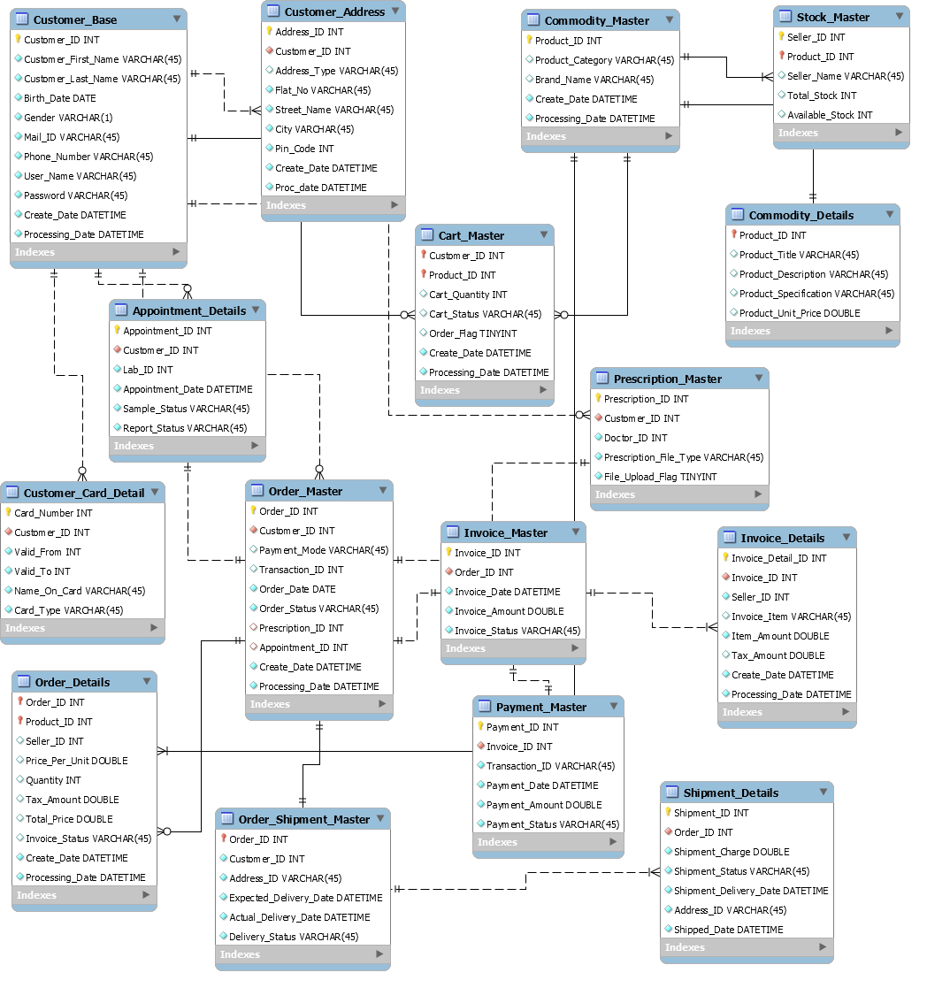
Entity Relationship Diagram

Slide 6
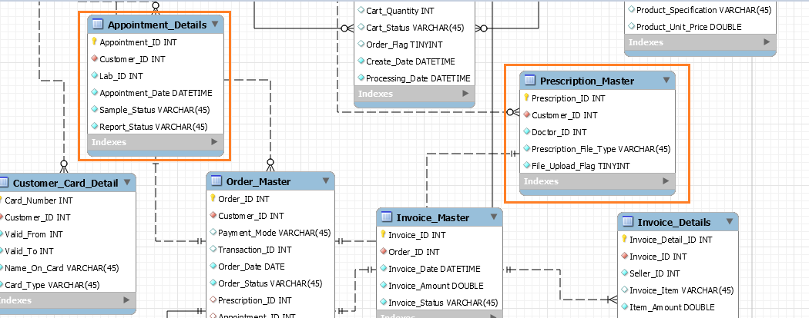
Entity Relationship Diagram

Slide 7
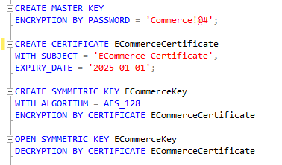
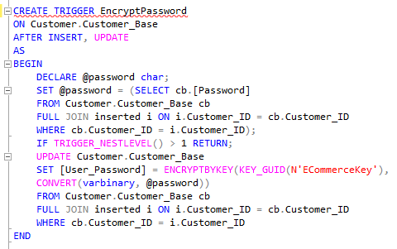
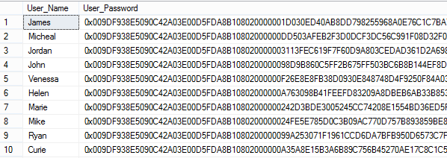
Database Implementation – Encryption & Decryption
The purpose of this function is to encrypt confidential data in our database. In this case we have encrypted Customer Password from Customer_Base table.

Slide 8
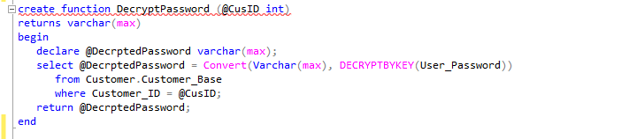

Database Implementation – Encryption & Decryption
Similar to encryption we can decrypt confidential data in our database using this function. In this case we have decrypted Customer Password from Customer_Base table.
The decrypted password for a sample Customer_ID is shown below.

Slide 9
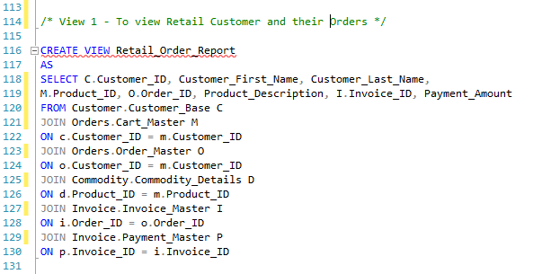
Database Implementation – Views & Computed Columns
The purpose of this view is to generate a report of Retail Customer Order

Slide 10
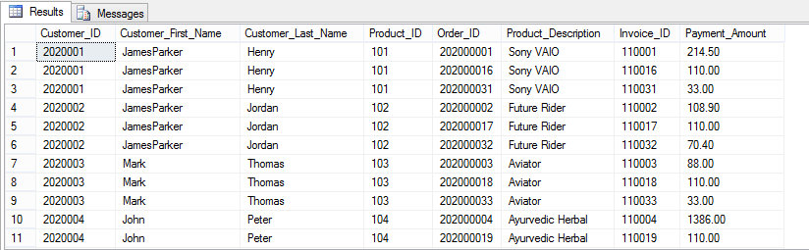
Database Implementation – Views & Computed Columns
Retail Customer Order View displays the output as below.

Slide 11
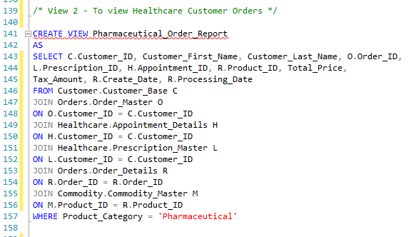
Database Implementation – Views & Computed Columns
The purpose of this view is to generate a report of Healthcare Customer Orders

Slide 12
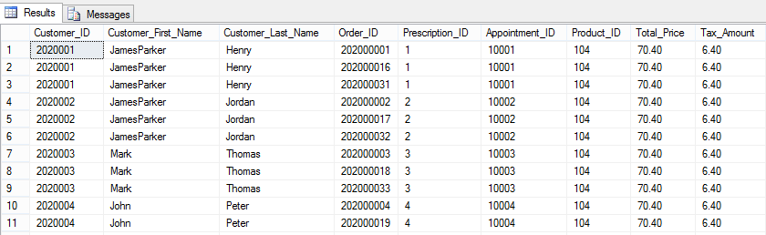
Database Implementation – Views & Computed Columns
Healthcare Customer Orders View displays the output as below.

Slide 13
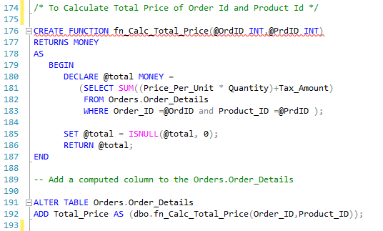
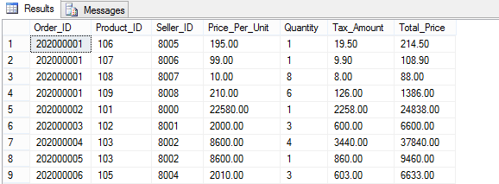
Database Implementation – Views & Computed Columns
Calc_Total_Price function calculates Total Price of each order id based on the price per unit, quantity and tax amount of the product.

Slide 14
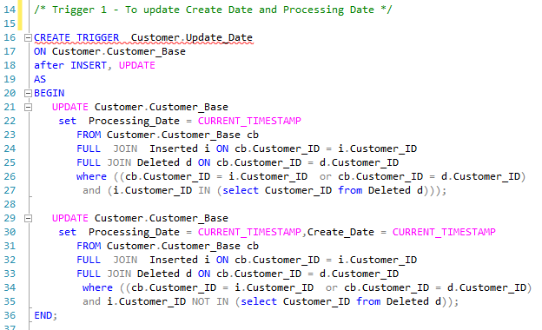
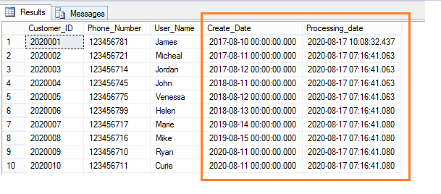
Database Implementation – Triggers & Table Check Constraints
Update Date trigger is used for updating create date and processing date attributes in an entity after Insert and Update of the record.

Slide 15
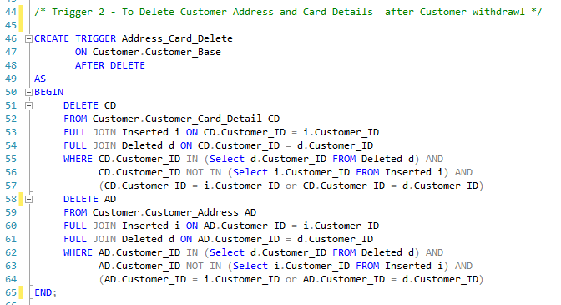
Database Implementation – Triggers & Table Check Constraints
Delete trigger is used for deleting customer address and card details once customer withdraws from the business.

Slide 16
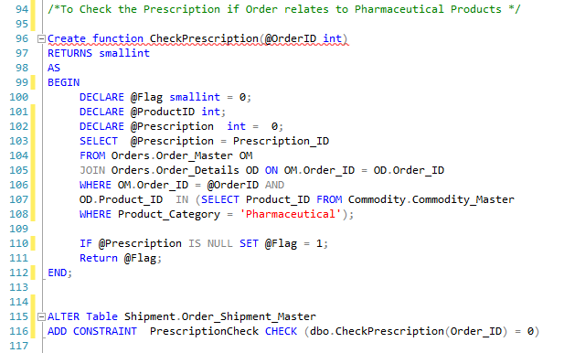
Database Implementation – Triggers & Table Check Constraints
CheckPrescription function is used to validate the prescription availability if order consists pharmaceutical products any.

Slide 17
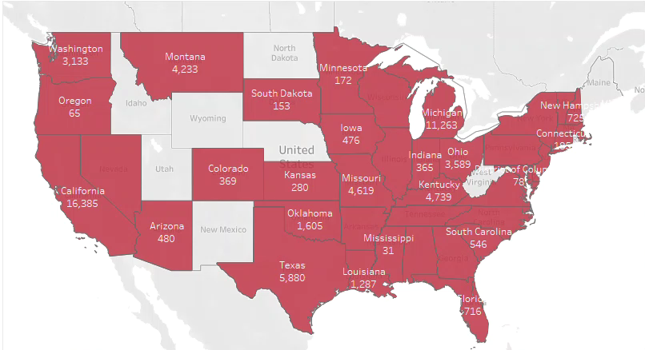
Data Visualization & Reports
Month-wise Geographical Sales Overview

Slide 18
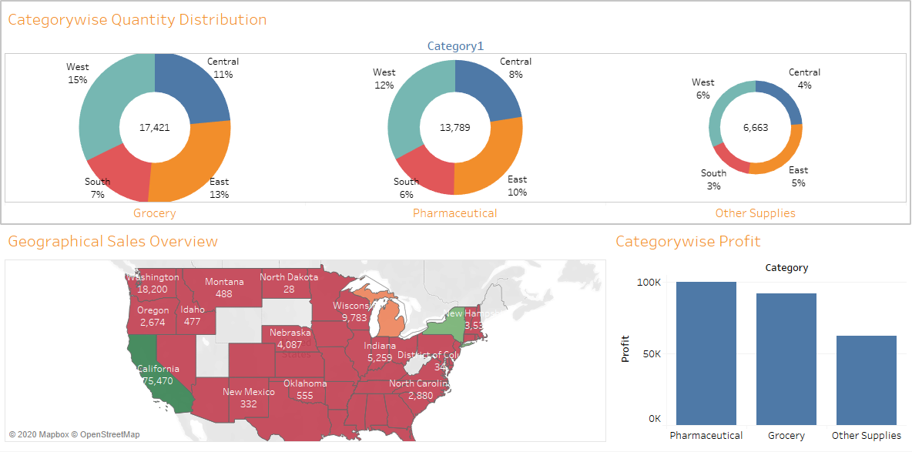
Data Visualization & Reports
Sales and Profit Dashboard

Slide 19
Q & A

